Slide 1
Ticket pricing for Big Mountain Resort
Prashant Bhargava

Slide 2
Problem Identification
Big Mountain Resort has recently installed an additional chair lift to help increase the distribution of visitors across the mountain. This additional chair increases their operating costs by $1,540,000 this season. To Maintain the business profitability, ticket pricing system for the resorts to improve. The business wants some guidance on how to select a better value for their ticket price
To find out the best suitable ticket pricing that does not affect the visitor's engagement and help in compensate the increase in operational cost in business for next skiing season.

Slide 3
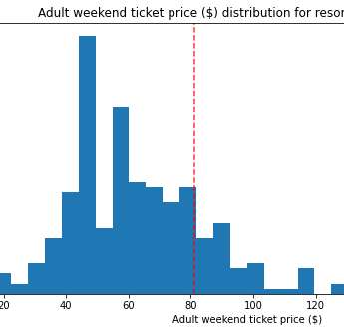
Recommendation and Key Findings
Big Mountain Currently charges ticket for adult is 81 dollars we have done some modelling based upon the data set of 330 resorts around USA we came with the increase in the pricing Big Mountain Resort modelled price is dollar 95.87. We have also used the Population and area per state number from wikipedia.
Ticket pricing depends upon small number of features out the given features like vertical_drop, Snow Making_ac, total_chairs, fastQuads, Runs, LongestRun_mi, Trams & SkiableTerrain_ac.

Slide 4
Modelling Results
Firstly applied simplest model by using mean as strategy.
As expected, if We use the average value as our prediction, we get an 𝑅2 of zero on our training set. R2 value 0.0031 on our test set.
Mean Absolute Error essentially tells us that, on average, we might expect to be off by around $19 if we guessed ticket price based on an average of known values.
Root Mean Square Error is around 24.78, 24.11 fro training and test set, respectively.
For better Understanding and better prediction of the ticket pricing we must test other models

Slide 5
Modelling Results
Linear Regression
We must Scale the data sets (training and test) with mean 0 and varinace 1 because of some features have different scale.
We see that our simple linear regression model explains over 80% of the variance on the train set and over 72% on the test set.
On average we did expect to estimate a ticket price within $9 or so of the real price.
Root mean Square error were 10.59 , 12.72 for training and test data set, respectively.
We were Must be overfitting feature on our model because of difference b/w the variance of training and test data set

Slide 6
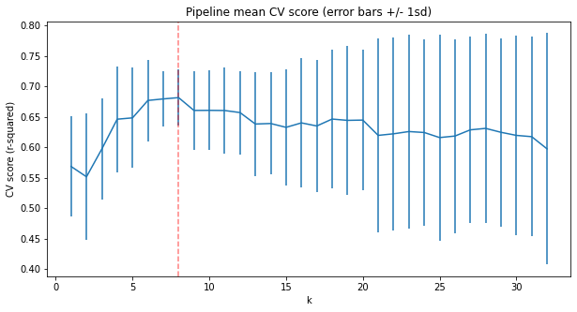
Modelling Results
Random Forest
We must find the k best feature for our model so that it's not overfitting on our data sets. By using selectKbest, cross_validation and GridSearchCV we have found that only 8 features are useful for modeling the data sets.
We see that our Random forest regression model explains over 71% of the variance on the train set and over 64% on the test set.
Apply linear model with k best feature the mean absolute error is 11.73 and apply the random forest regression the mean absolute error is 9.53.
The random forest model has a lower cross-validation mean absolute error by almost $1. It also exhibits less variability. Verifying performance on the test set produces performance consistent with the cross-validation results.

Slide 7
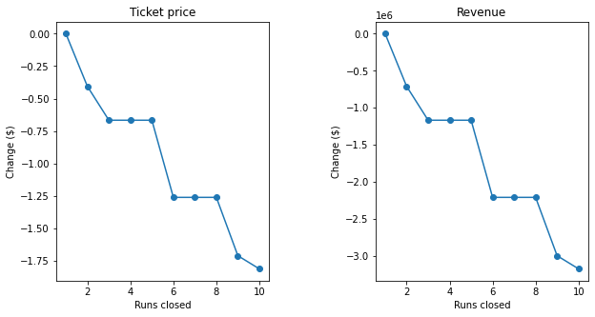
Analysis
Checked some different Scenairoes on which the prices for the ticket effect by increasing or decreasing the best k features of our data sets.
Deceasing the runs on the sking season. The model says closing one run makes no difference. Closing 2 and 3 successively reduces support for ticket price and so revenue.
By increasing the vertical drop, chair and run by 150 feet ,1 and 1 respectively.This scenario increases support for ticket price by $1.99. Over the season, this could be expected to amount to $3474638.
By just increasing some amount of snow making there wil be no effect on the pricing or increasing the longest run also.

Slide 8
Summary & Conclusion
Big Mountain Currently charges ticket for adult is 81 dollors we must do some modelling based upon the data set of 330 resorts around USA we came with the increease in the pricing Big Mountain Resort modelled price is $95.87, actual price is $81.00.
Even with the expected mean absolute error of dollor 10.39, this suggests there is room for an increase.
This could be expected to amount to $3474638 over 350000 people visits our resort he additional operating cost of the new chair lift per ticket (based on each visitor on average buying 5 days tickets) in the context of raising prices to cover this.
There are some deficiencies in data set like if we have visitor data for all the resorts and maybe some of data is not correct like terrain area and sking area etc. If the operational cost of other faclities were provided then price can be improved.

